Slide 1
Centenary University Billing Tutorial
By Centenary University IT Department
in combination with
Registrar’s Office / Bursar’s Office

Slide 2
Billing
Now that you have registered for classes you can view your billing statement.
The payment schedule for tuition and fees for full-time students is posted on the College’s web site – www.centenaryuniversity.edu – under Tuition and Billing/Bursar Office.
Part-time undergraduate and graduate students are expected to make the appropriate tuition payment within seventy-two hours of their registration being posted.

Slide 3
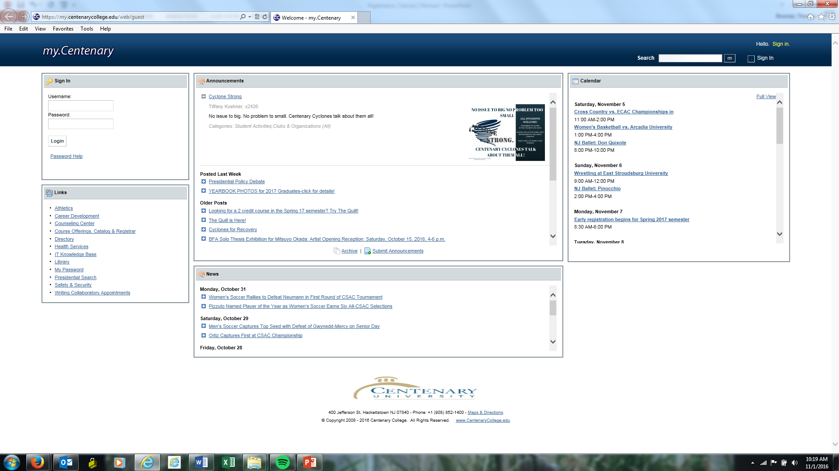
Your billing statement can be accessed by logging into my.centenarycollege.edu
Your billing statement can be accessed by logging into my.centenaryuniversity.edu using your Centenary username and password

Slide 4
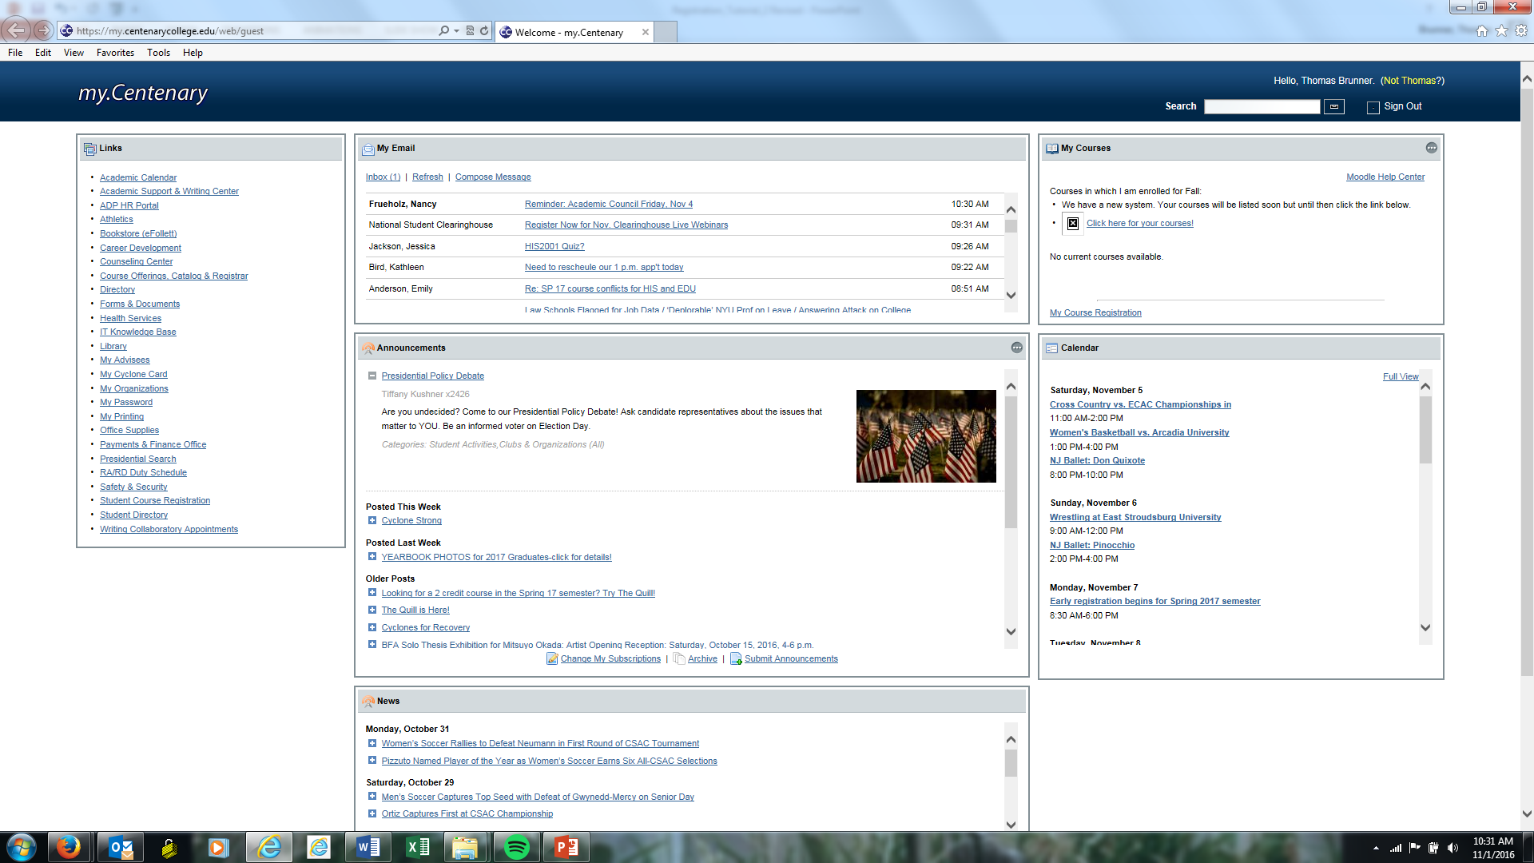
In the navigation pane on the left, click on “My Billing Ledger.”

Slide 5
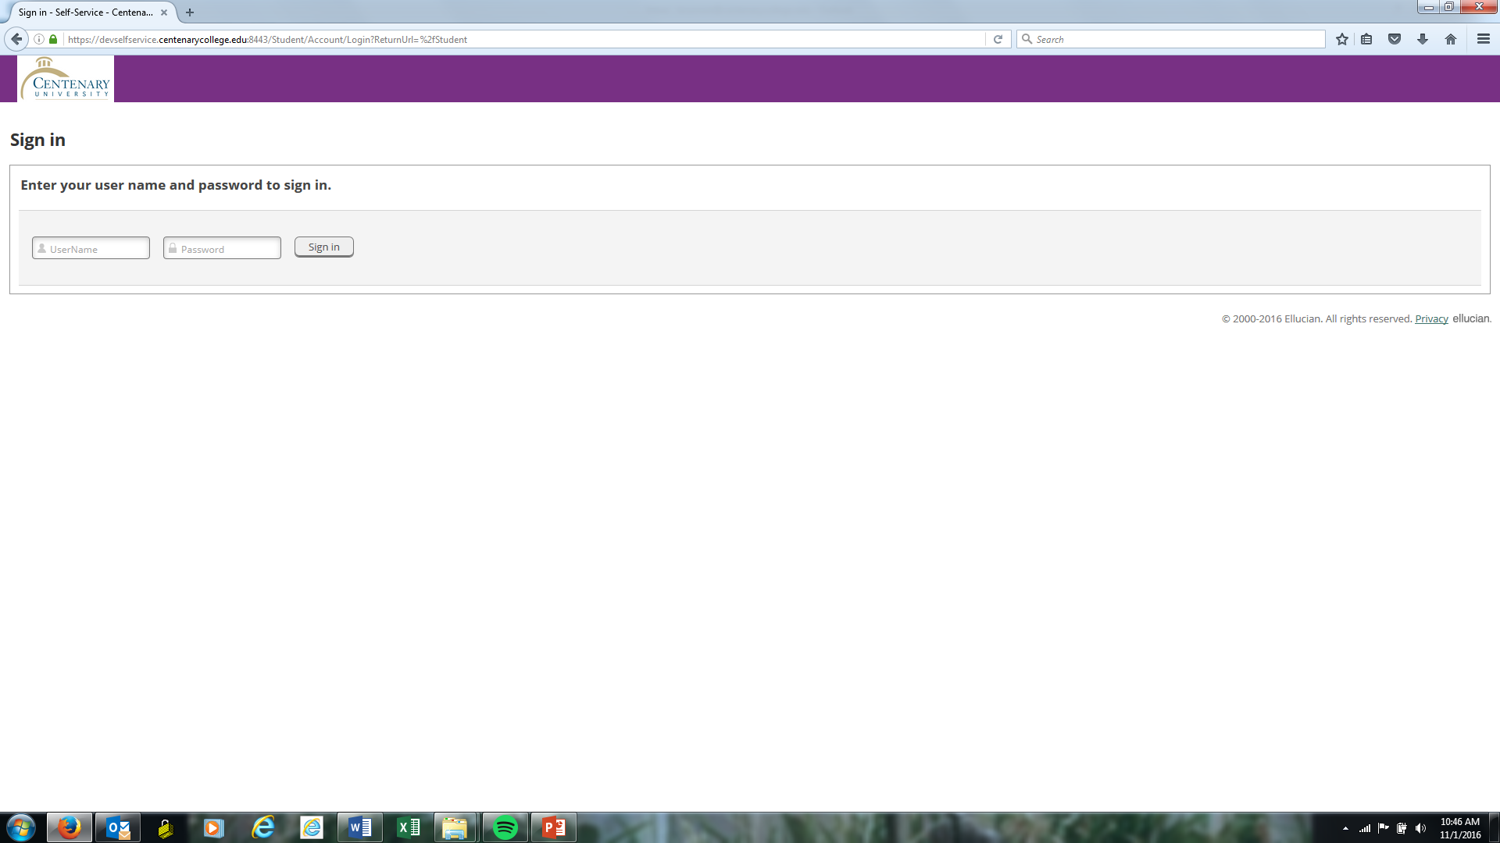
Log back into the self-service portal using your Centenary user name and password

Slide 6
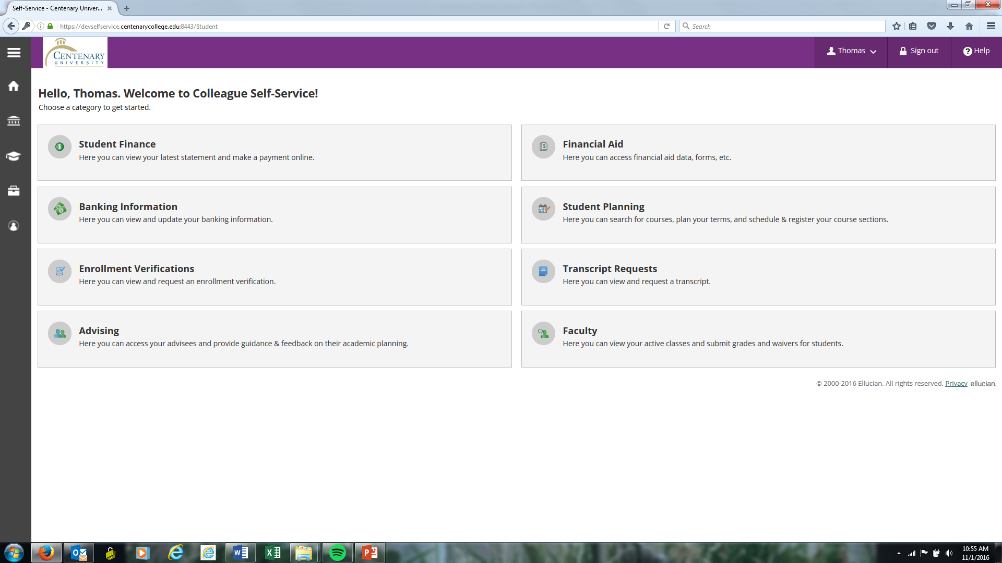
This will take you to the “Welcome to Colleague Self-Service” page. Select the “Student Finance” tab

Slide 7
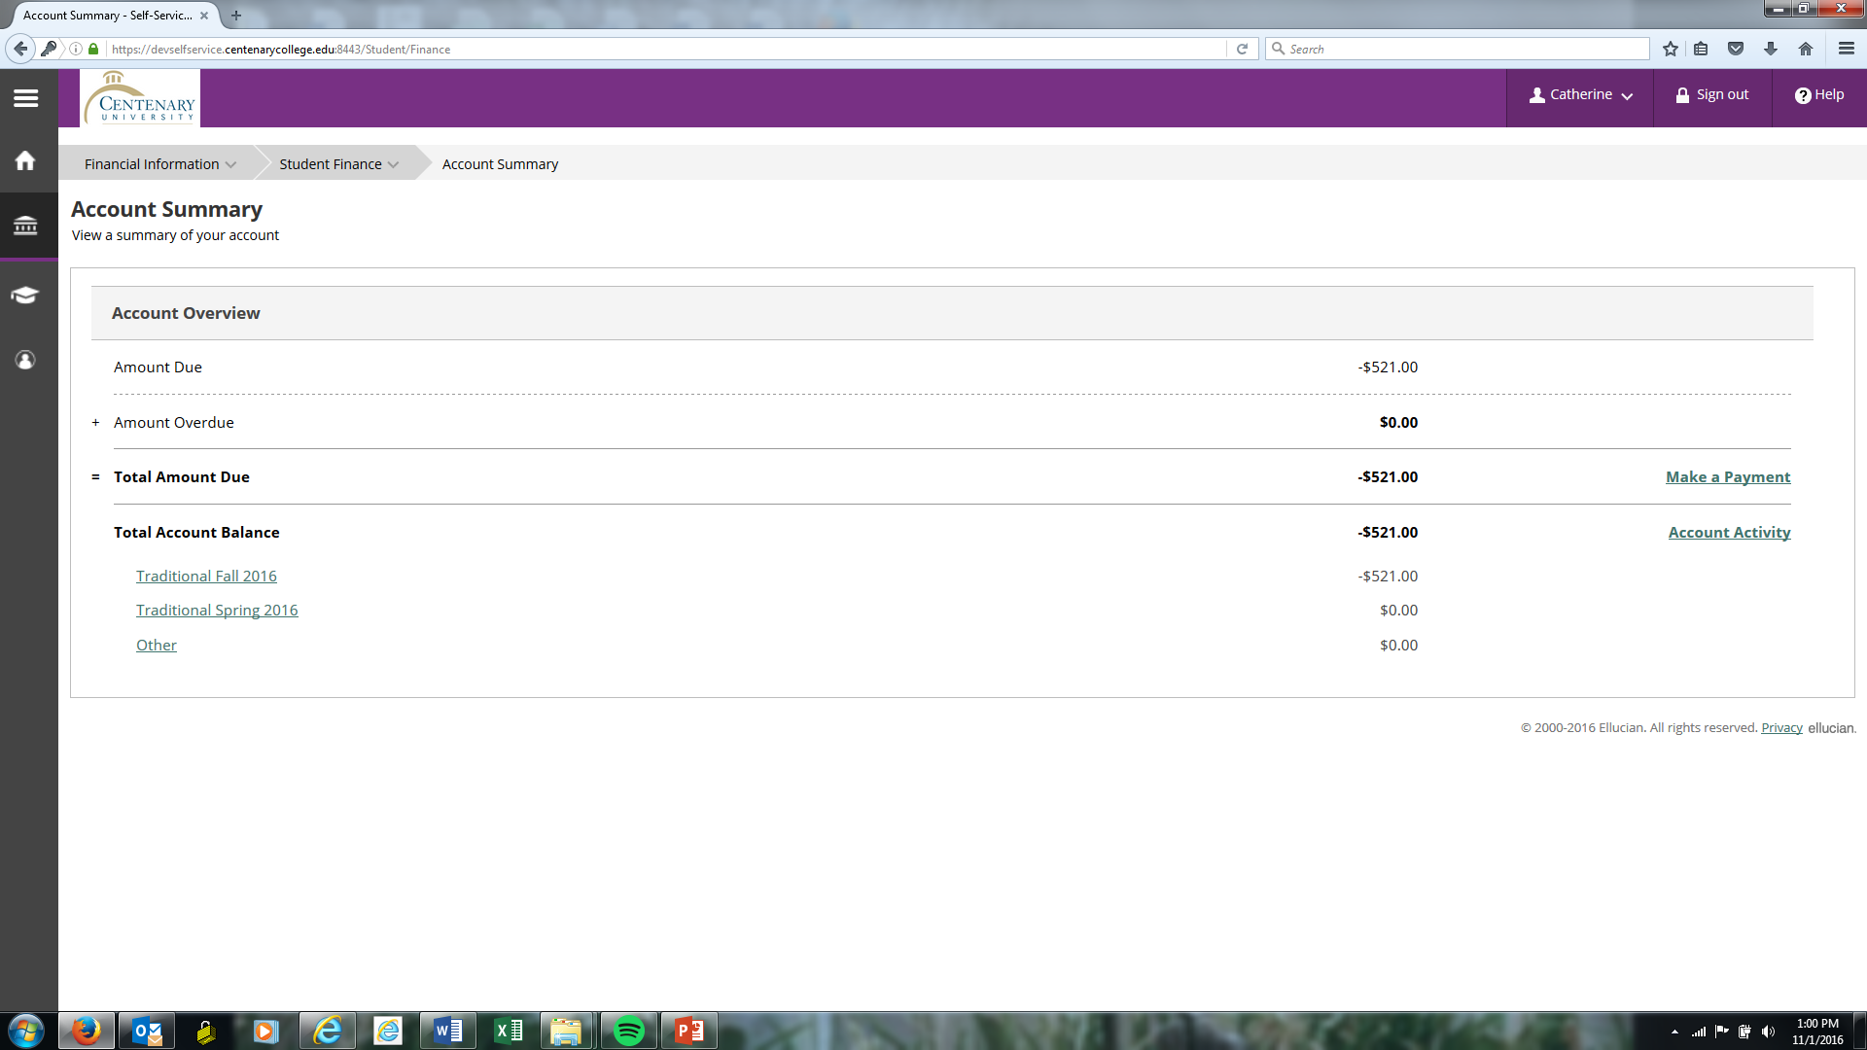
The first page of a student’s finance displays one’s account summary. Here student’s can view their account balances, including any amounts due, amounts overdue, and total account balance. On the left are links showing present and past terms as well as other amounts due. On the right are links that will take students to the “make a payment” page or “account activity” page.

Slide 8
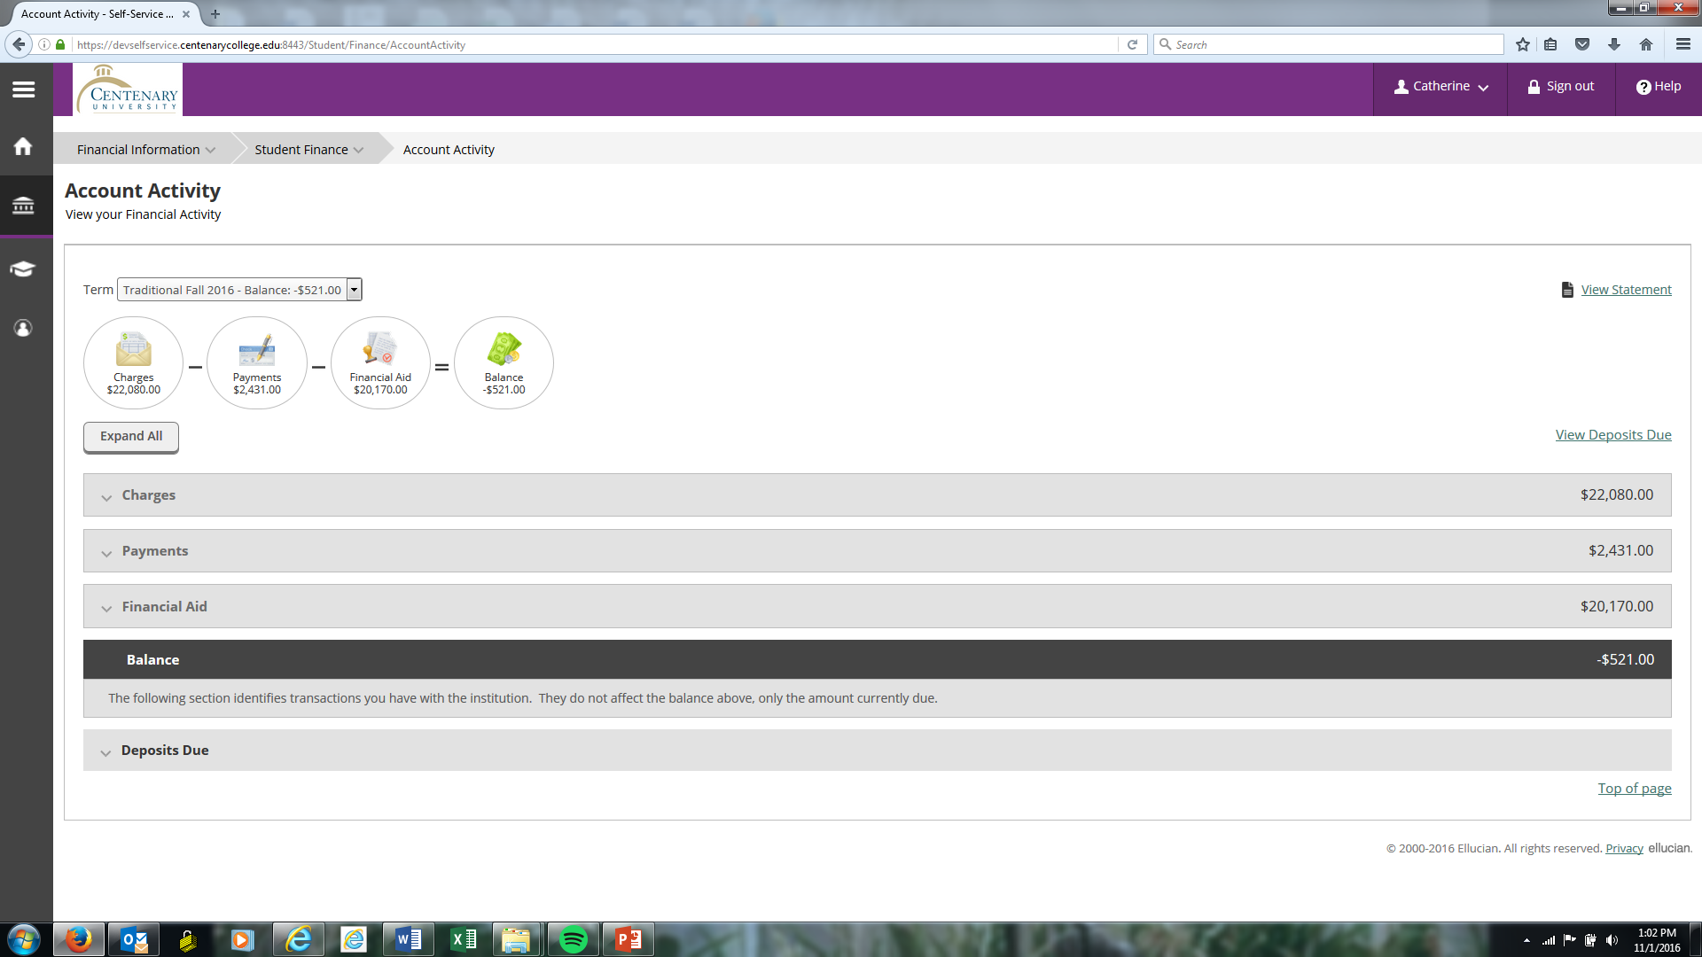
On this page you can review your billing charges, payments made, and financial aid awarded.
To view details for a different term, click on the drop down arrow in the “Term” box and select the term you wish to view.

Slide 9
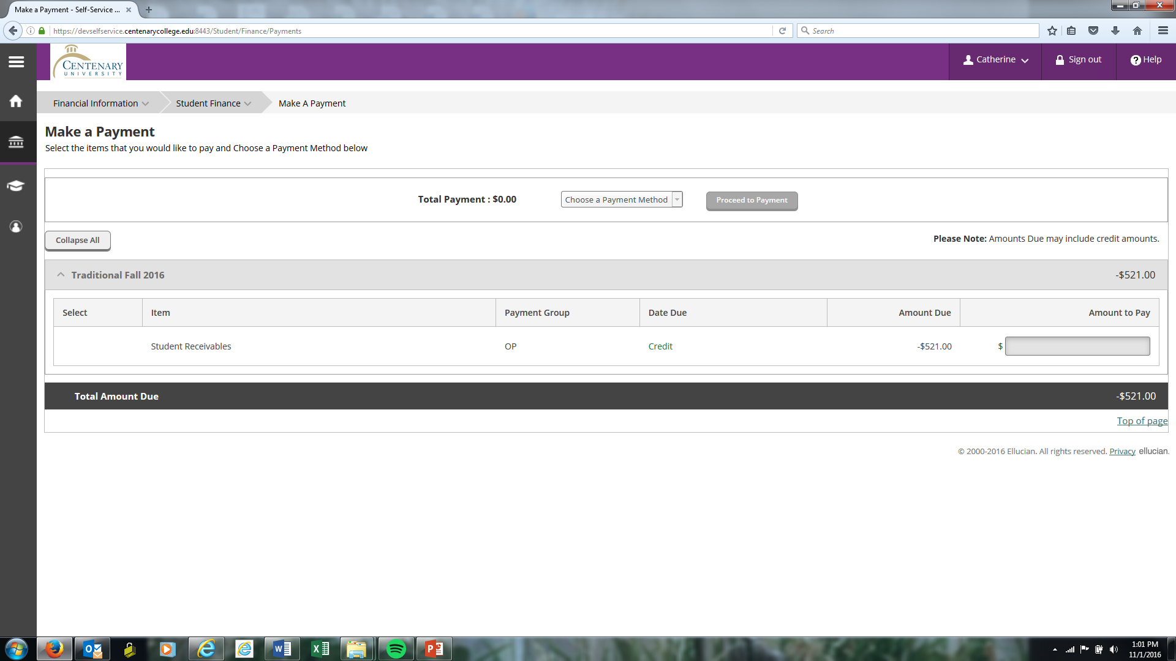
After reviewing your charges, you are able to select the charge or charges you are going to pay by checking the appropriate box or boxes on the left.
Note that you can also change the amount of the payment being made. Full payment must be made by the due dates set by the College.
You also can select the payment method you are going to use by clicking the “Choose a Payment Method.”
At this point, click on the “Proceed to Payment” tab located in the top right corner.
A confirmation screen will appear. This is where you confirm the accuracy of the payment to be made.

Slide 10
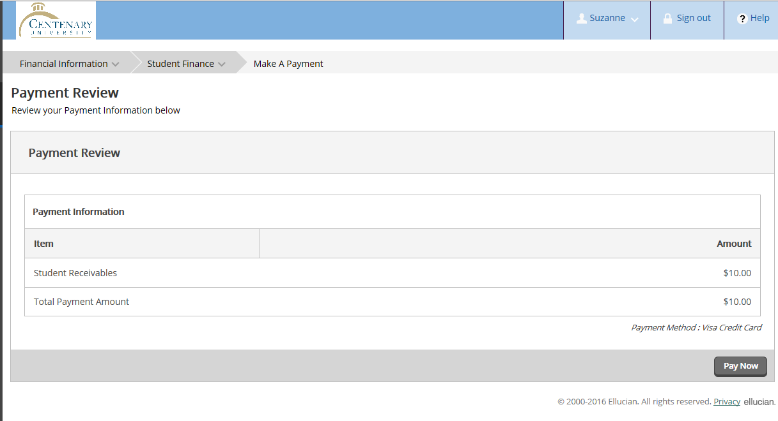
Also, please confirm that the Payment Method you selected appears accurately.
When you click the “Pay Now” tab, your payment will be processed electronically. Electronic payment is either through credit card or by electronic check. Payments by checks received through the USPO are handled separately.
Effective November 7, 2016, payments made by credit/debit card will be subject to a 2.65% service fee.

Slide 11
Please direct questions or issues to one of the following offices: Technological Issues: The Centenary College IT Helpdesk at 908-852-1400, x2000 Billing Questions: Centenary College Student Billing Office at 908-852-1400, x 2245 Financial Aid Questions: Office of Financial Aid at 908-852-1400, x 2350 Registration Issues: Registrar’s Office at 908-852-1400, x 2214

